Slide 1

24CSA212 –
Full Stack Frameworks
Data modelling with mongodb

Slide 2
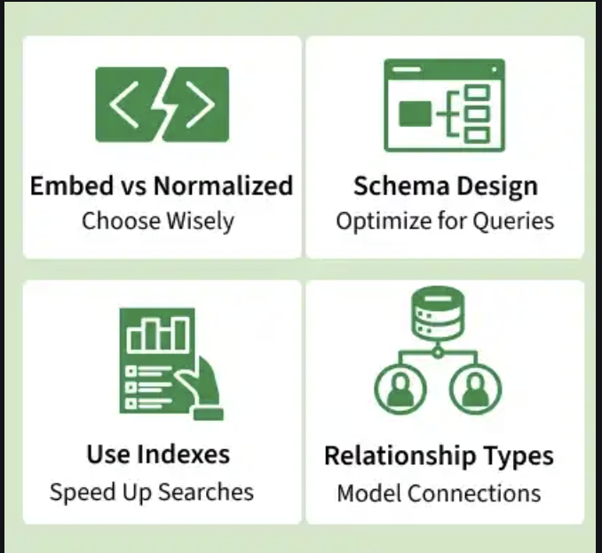
Data Modelling in MongoDB
MongoDB data modeling focuses on structuring documents and collections in a way that matches application access patterns, improves query performance, and supports future scalability using MongoDB’s flexible schema.
Designs document and collection structures for efficient storage and queries.
Leverages flexible schema for dynamic and evolving data.
Optimizes for application access patterns (reads/writes).
Improves database performance via efficient storage and indexing.
Plans for future scalability and changing requirements.

Slide 3
MongoDB Data Model Designs
For modeling data in MongoDB, two strategies are available. These strategies are different and it is recommended to analyze scenario for a better flow.
The two methods for data model design in MongoDB are:
1. Embedded Data Model
2. Normalized Data Model

Slide 4
Embedded Data Model
The Embedded Data Model stores related data within a single MongoDB document, improving read performance by keeping frequently accessed information together and reducing the need for joins.
Stores related data as sub-documents in one document.
Reduces the need for cross-collection joins.
Improves read performance for related data.
Supports atomic updates on a single document.

Slide 5
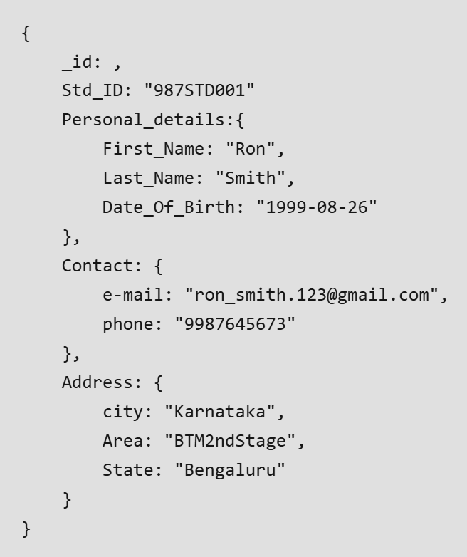
Embedded Data Model example
If we obtain student information in three different documents, Personal_details, Contact, and Address, we can embed all three in a single one, as shown below.

Slide 6
Embedded Data Model Advs and Disadvs
Advantages of the Embedded Model:
Faster reads: All related data is fetched together, reducing the need for multiple queries.
Atomic operations: Data is stored in a single document, ensuring atomic write operations (a single document is updated at once).
Disadvantages:
Data redundancy: Data may be duplicated, increasing storage usage.
Limited by document size: MongoDB documents have a size limit of 16MB.

Slide 7
Normalized Data Model
The Normalized Data Model stores related data in separate collections and links them using references, reducing duplication and supporting complex relationships across collections.
Links related data across collections using references (IDs).
Reduces duplication and supports complex relationships.
Suitable for large, shared, hierarchical datasets.

Slide 8
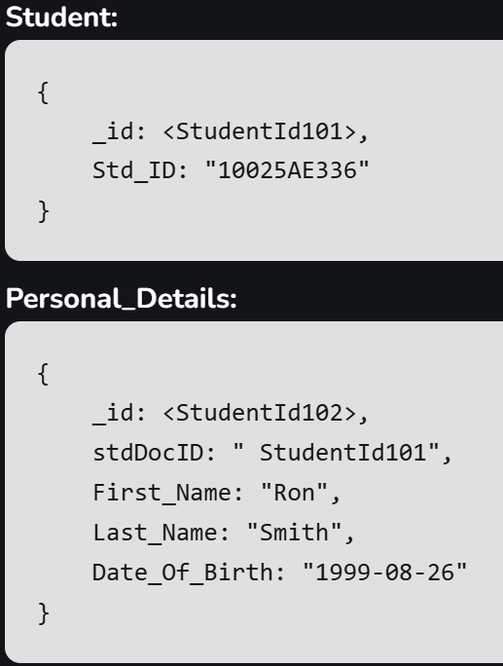

Normalized Data Model Example
Created multiple collections for storing students data which are linked with _id.

Slide 9
Normalized Data Model Advs & Disadvs
Advantages of the Normalized Model:
Reduces data redundancy: Common data (e.g., personal details) is stored once and referenced where necessary.
Efficient for many-to-many relationships: Works well for complex relationships between data.
Disadvantages:
Slower reads: Requires multiple queries or joins to retrieve related data, which can impact performance.
More complex to manage: Managing relationships between collections can be more difficult.

Slide 10
Advantages Of Data Modeling in MongoDB
Data modeling in MongoDB helps design efficient schemas that improve performance, simplify development, and support long-term scalability and maintenance.
Boosts application performance with optimized schema design.
Speeds up development cycles through easier object mapping.
Improves data understanding, standards, and validation.
Supports future scalability and maintainability of applications.

Slide 11
Best Practices in Data Modelling
Some important points to consider while creating a data model for MongoDB database are:
Design Based on Application Needs: Model the data according to how it will be accessed (e.g., frequent queries, updates, etc.).
Separate Collections for Different Entities: Store unrelated data in separate collections to reduce complexity.
Embed Frequently Accessed Data: For better performance, embed related data that will be accessed together in a single document.
Avoid Complex Joins: Perform joins during writes, not reads, to optimize query performance.
Use Aggregation: Leverage MongoDB's aggregation framework to perform complex queries and transformations.

